Slide 1
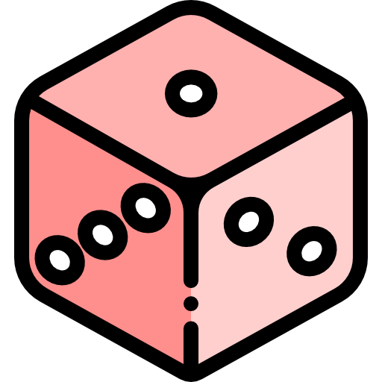
BEAT YOUR BOARDOM!
joseph chin, jeffrey fulkerson, helena shi, abhinaya a.
Notes:
Helena
Who here is doing something fun this weekend, that’s NOT r homework, or studying for python, or obsessively checking LinkedIn? Well, if you are looking for a way to relax, might we suggest playing a board game with some friends! Not sure what to play? No problem! We’re group 12, and we’re presenting our analysis on board game data!

Slide 2
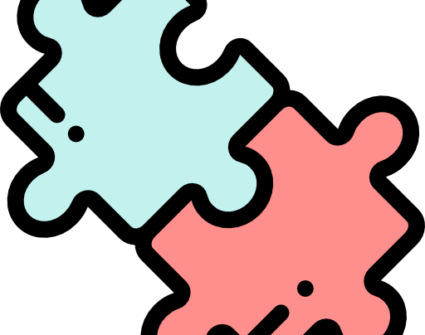
agenda
Introduction
Recommendations
Exploratory Analysis
Prediction Models
Notes:
helena

Slide 3


why board games?
$8.12 BILLION
PRICELESS!
Notes:
helena
According to Statistica.com, “In 2016, the global board games market was valued at approximately 3.2 billion U.S. dollars.” The forecast in 3 years, for 2021, shows a projected value of 8.12 billion dollars!!! Which is a lot of money! If board game was a country, it’d be ranked 142 in the world. :O
Not only that, but board games have come so far in technology and game design. By combining the nostalgia of family tabletop evenings with innovative advances in design, games like Ticket to Ride have huge followings, and board game lovers have created their own unique culture. Board games bring people together, and that is PRICELESS!

Slide 4
the ultimate questions
What features can we recommend our clients to produce the highest ratings in a new game?
If a user inputs certain characteristics, can we recommend a similar game for them to try?
Notes:
helena

Slide 5
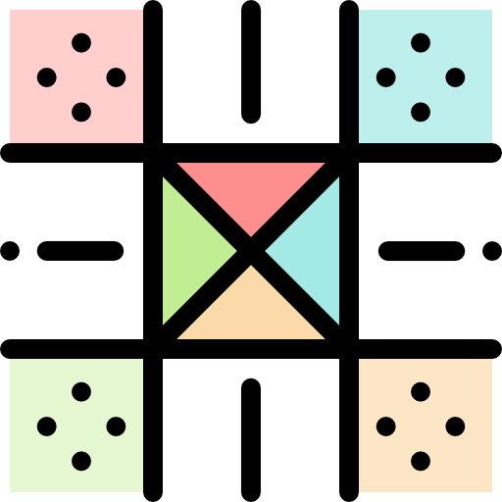
recommendations

Slide 6



complex & longer games
target 13-21
year olds
wargames w/ card drafting
Notes:
Complex, longer games targeting mature audiences is the best combination to break into the board game market in 2018. Wargames with card drafting mechanics are gaining popularity in 2018. Dean Essig is the best board game designer given these requirements.

Slide 7
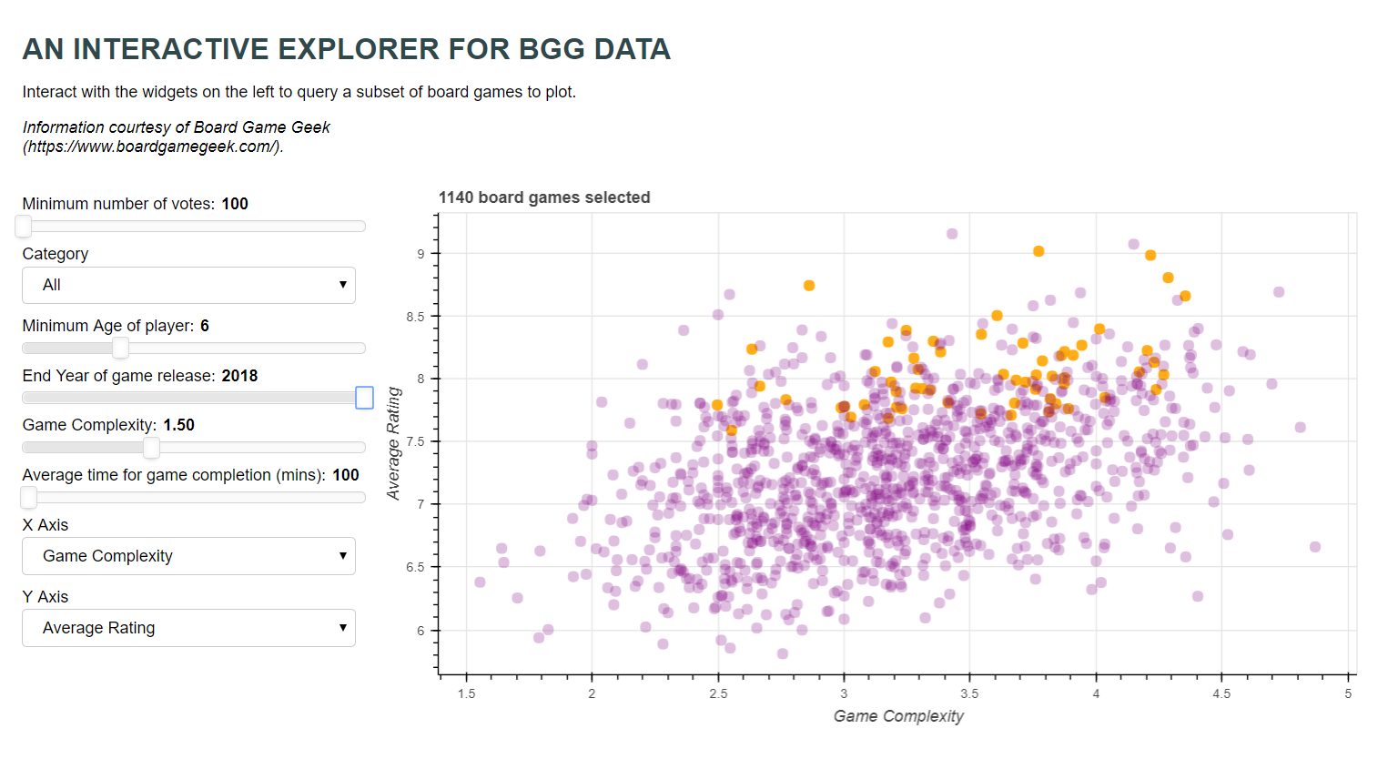

Slide 8
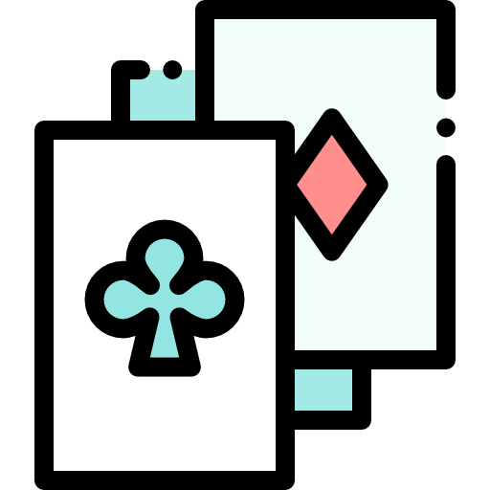
data & cleaning

Slide 9
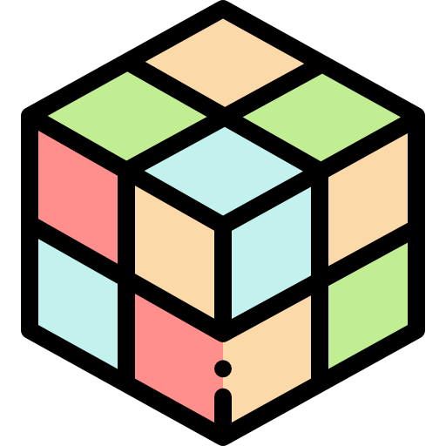
our data
Board Game Geek
5000 unique board games
Average ratings vs. geek ratings
Minimum/maximum players, average play time, category, mechanic, & weight/complexity
Notes:
Joseph
Board Game Geek (BGG) is a board game database - a collection or catalog of data and information on traditional board games.
cleaning1. when min players are 0, those are actually books/not a game2. Tried to remove outliers at first, dropping bottom and top 10% of num_votersHowever, saw that it was Catan, which is hugely popular! So was not able to do it in our case 3. So we just filtered it so that we dropped games with less than 100 votes, to make sure we were only hitting games that were more thanobscure, but also not ignoring what might be untapped potential.normalization:highly skewed, thus do normalization1. normalize avg_rating: on a scale of 0-12. normalize #vote and owned on a scale of 0-1 categorizationregression, figured that there is no strong linear relationship, thus try categorization1. min_players2. max_players3. age
Various variables: Average ratings, geek ratings, and characteristics such as minimum/maximum players, average play time, category, mechanic, and weight/complexity
One unique variable to note is geek_rating. This is basically average_rating, but with a penalization by using num_votes to prevent games with relatively few votes from climbing to the top of the ranks.

Slide 10
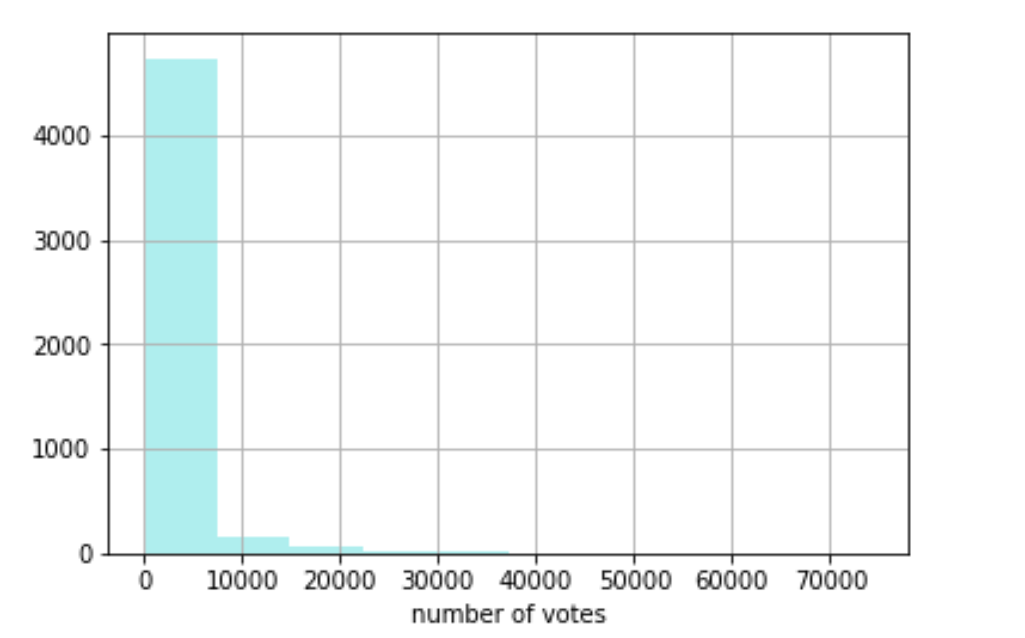
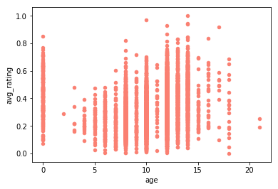

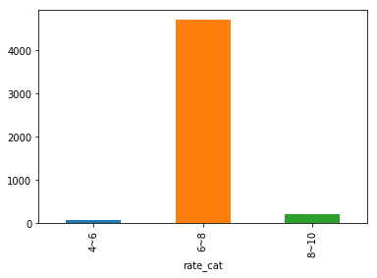
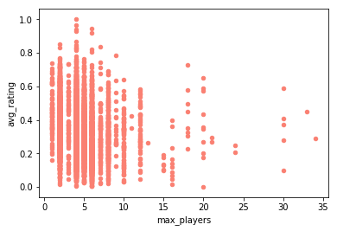
cleaning data
Catan!
74261 votes
Cleaning
Normalization
Categorization

Slide 11
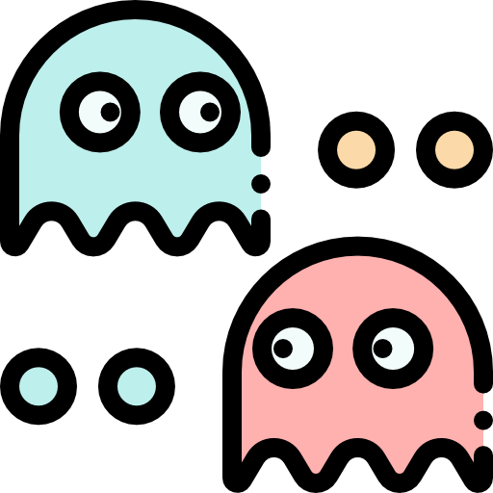
data analysis

Slide 12
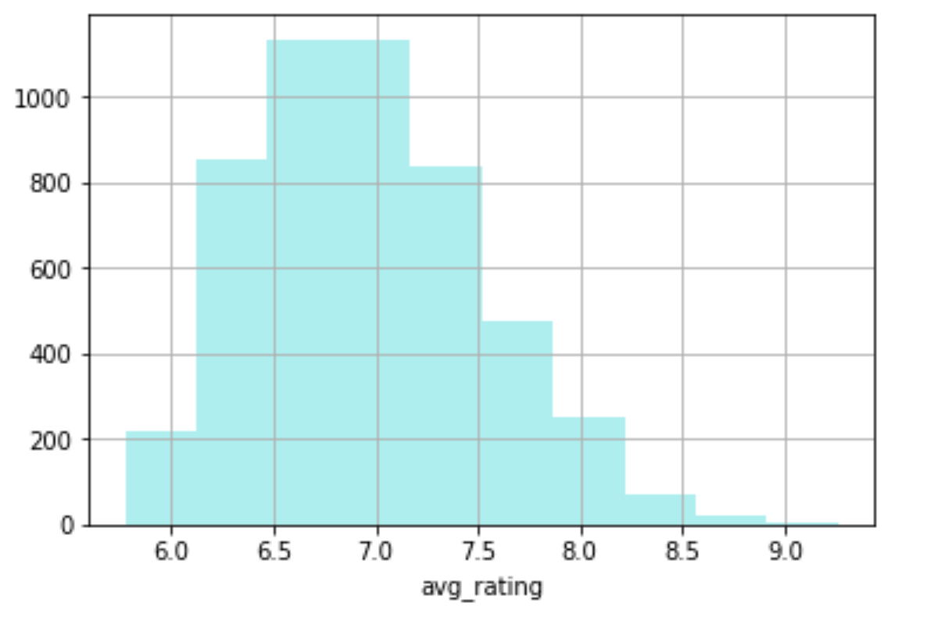
the challenges of survey data
Average Rating:
Range is 5.77 - 9.26
Most people rate between 6.1 - 7.5
People are too polite!
Notes:
abby
Surveys mean that there are PEOPLE behind the laptop, answering these questions.
Often times, especially with questions where one is asked to rate something, people want to be polite! As you can see in our range of avg_rating column, the range of answers is between 5.77 and 9.26, on a 0 - 10 scale. People don’t want to be mean and rate a board game as 1 or 2. Furthermore, our histogram shows that the highest frequency of scores is between 6.1 - 7.5...which is neither good nor bad.

Slide 13
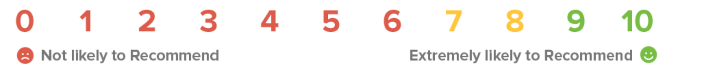
what is NPS?
detractors
0 - 6
could damage company reputation
passives
7 - 8
somewhat satisfied, but switch easily
promoters
9 - 10
loves products,
enthusiastic recommender
Notes:
abby
NPS stands for Net Promoter Score. It is an index ranging from -100 to 100 that measures the willingness of customers to recommend a company’s products or services to others. It is used as a proxy for gauging the customer’s overall satisfaction with a company’s product or service and the customer’s loyalty to the brand.
After being surveyed on a particular questions, customers are classified into 3 categories, detractors, passives, and promoters.

Slide 14
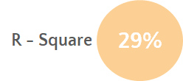
weight (complexity)
Complex games are popular
Notes:
jeffrey

Slide 15
number of players
7%
R - Square
Two-player games are popular
Notes:
jeffrey

Slide 16
age
14%
R - Square
Board games are gaining popularity amongst mature audiences
Notes:
jeffrey

Slide 17
average time
14%
R - Square
Longer board games are the most popular
Notes:
jeffrey

Slide 18
categories
Wargame
Adventure
Modern Warfare
Aviation Flight
Economic
Notes:
jeffrey
Top 5 game designers:Dean EssigJohn H ButterfieldVlaada ChvtilAdam CarlsonGene BillingsleyUwe Rosenberg

Slide 19
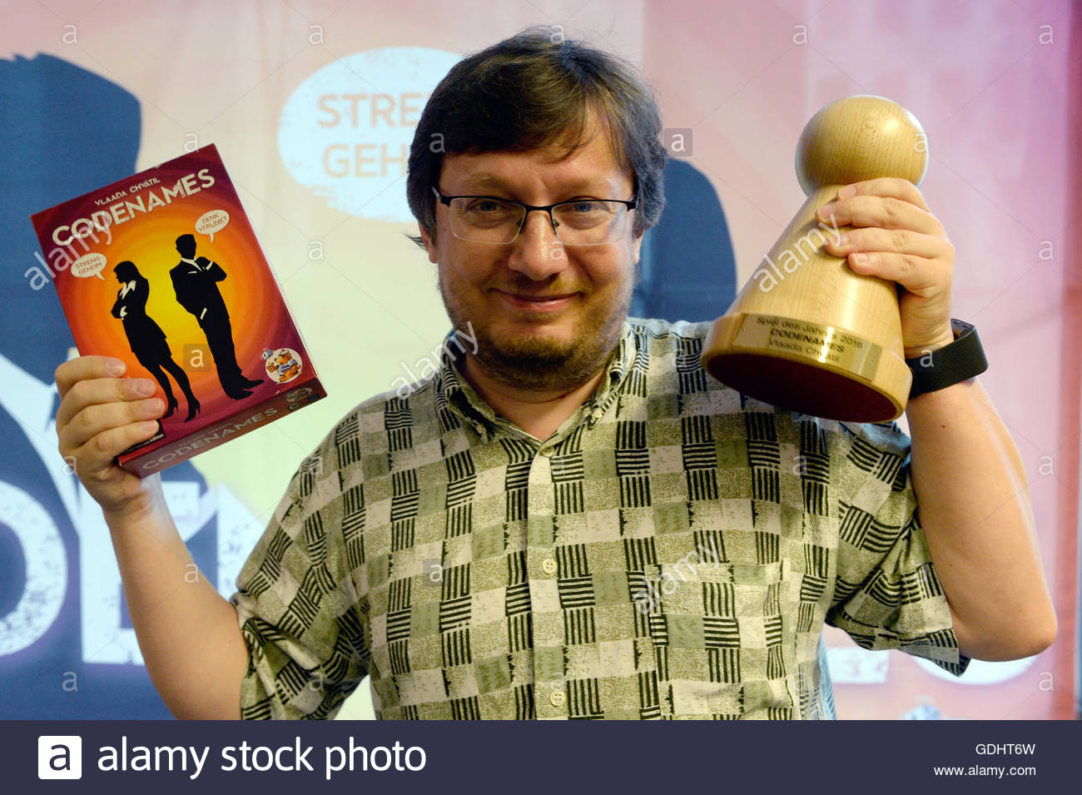
the designer
Dean Essig
John H Butterfield
Vlaada Chvatil
Adam Carlson
Gene Billingsley
Notes:
jeffrey
Top 5 game designers:Dean EssigJohn H ButterfieldVlaada ChvtilAdam CarlsonGene BillingsleyUwe Rosenberg

Slide 20
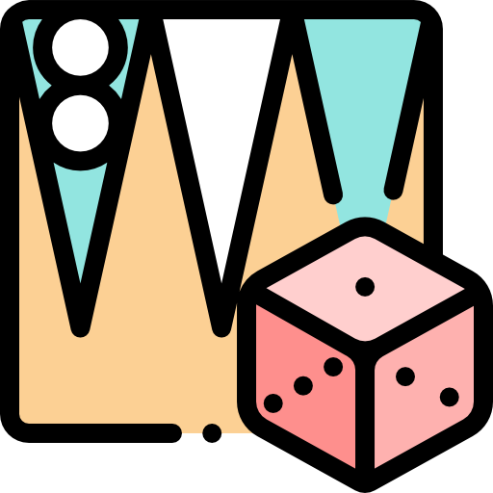
prediction models

Slide 21
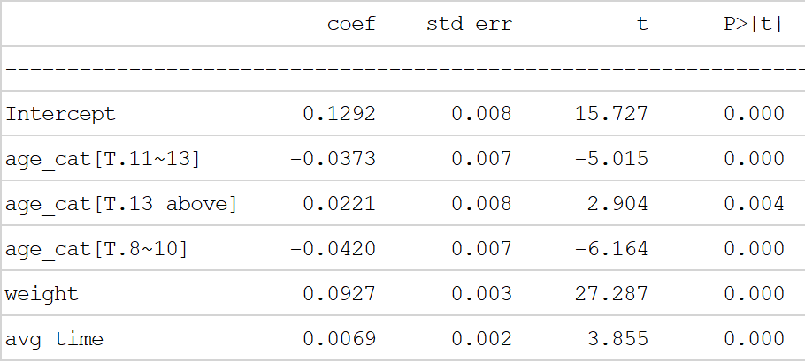
regression model
'avg_rating ~ weight + age_category + avg_time’
R-squared: 0.311
RMSE: 0.155
Notes:
joseph

Slide 22
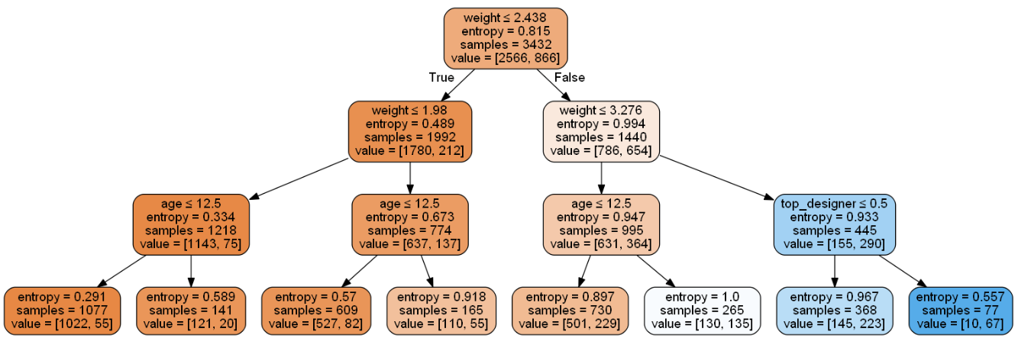
tree
77%
Accuracy =
Notes:
Abby
Accuracy = 77%
Complex, longer games targeting mature audiences is the best combination to break into the board game market in 2018. Wargames with card drafting features are gaining popularity in 2018. Dean Essig is the best suited board game designer for your needs

Slide 23

thank you! questions?

